Slide 1
Investigation and Novel Implementation of BatchBoost: a regularization and stable neural network learning technique
Data Science Laboratory Project
Autumn Semester (2019-20)
Mentored by: Dr. Sujoy Bhattacharya
IIT Kharagpur, West Bengal
Project Contributors: -
Bhushan Jayant Chaudhary (19BM6JP59)
Gaurav (19BM6JP40)
Piyush Raj Gupta (19BM6JP31)

Slide 2
Problem Statement
Large and Deep Neural Network architectures have met significant development and find their applications in a variety of computer vision, speech recognition and reinforcement learning tasks
Neural network architectures are sensitive to: -
UnderFitting
OverFitting
A few techniques have been proposed in the recent times to tackle these challenges like: -
Data Augmentation b) Stochastic gradient descent c) Label Smoothing d) Mixup e) Sample Pairing f) BC Learning
Our Approach: -
In order to further improve the performance of Neural Networks, we try to implement and investigate a novel technique called BatchBoost for image classification task on a publicly available CIFAR10 dataset that suggests multiple mixing of samples in multiple mini-batches can infuse a nonlinear relationship into the architecture.
1

Slide 3
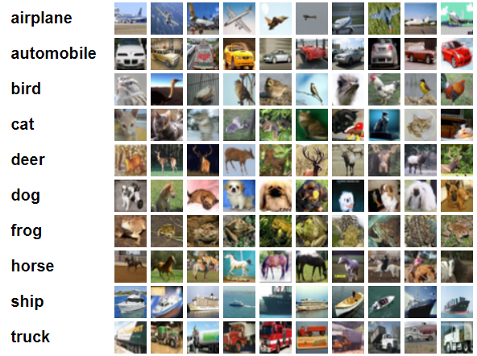
Dataset (CIFAR-10)
CIFAR-10 is an established computer-vision dataset used for object recognition. It is a subset of the 80 million tiny images dataset and consists of 60,000 32x32 color images containing one of 10 object classes, with 6000 images per class. It was collected by Alex Krizhevsky, Vinod Nair, and Geoffrey Hinton.
For each class: -
Training observations : Test observations = 5 : 1
a
10 Classes
2

Slide 4
Overall Experimental Methodology
Transfer Learning + batchboost
Transfer Learning using EfficientNetb0
Deep CNN + Augmentation + Regularization
Deep CNN + Dropout + Normalization
Deep CNN
Baseline
3

Slide 5
Techniques Studied

Slide 6
Image classification using Vanilla Neural Networks
Baseline Model – 2 CNN + 2 FC
Top 1 Accuracy – 65.87%
Image
Conv1
Conv2
Pool1
FC1
FC2
Deep CNN Model – 6 CNN layers + 2 FC
Top 1 Accuracy – 67.20%
FC1
FC1
Pool2
Conv6
Conv5
Conv3
Pool2
Conv1
Conv4
Image
Conv2
Pool1

Slide 7
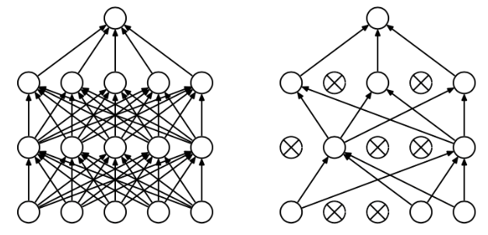
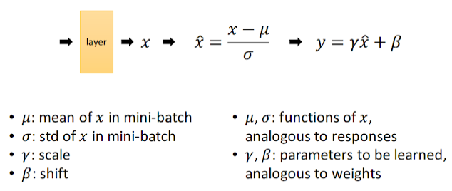
Regularization
Regularization is modification to algorithm is intended to reduce its generalization error but not its training error.
Dropout
Randomly Selected Neurons are ignored in each training step.
Dropped Neurons don’t have effect on next layers.
Dropped neurons are not updated in backpropagation.
Batch Normalization
Reduces internal covariance shift
Make algorithm robust to variations in input
Accuracy after Regularization = 78%
5

Slide 8
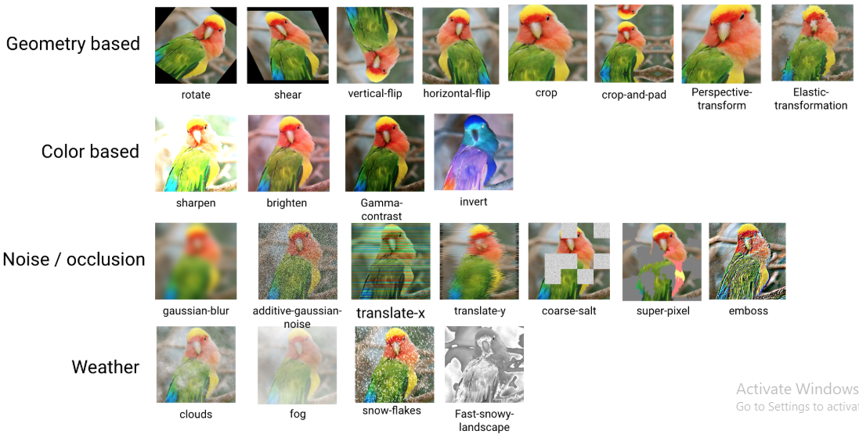
Image Augmentation
Image augmentation is a technique that is used to artificially expand the data-set.
Top 1 Accuracy after applying regularization and Image Augmentation = 87.17%
6

Slide 9
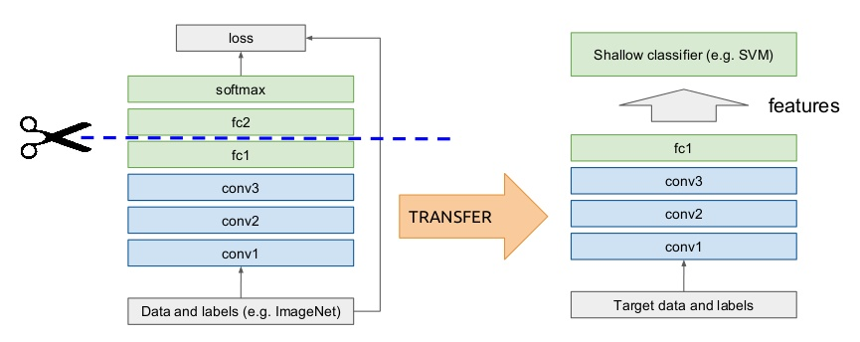
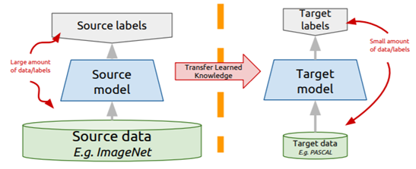
Transfer Learning
Take a network trained on different domain (ImageNet) for different source task (CIFAR100)
Adapt it for your domain and your target task
Top 1 Accuracy achieved using EfficientNetb0 = 94.71%
7

Slide 10
Sample Pairing Techniques

Slide 11
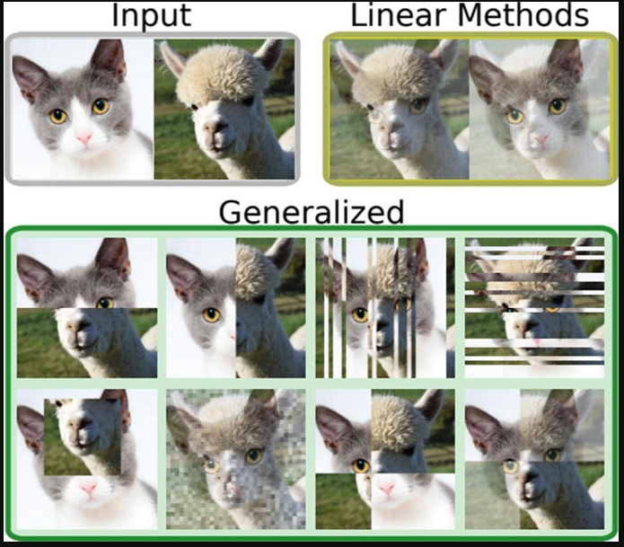
Traditional Pairing Techniques for further improvement
Sample Pairing - Pairs two or more sample images & their labels and feeds it to the model.
Traditionally, there are multiple methods of image pairing including Mixup, Sample Pairing and BC Learning.
We investigated batchboost as a method of pairing image samples and implemented its ideology on CIFAR10 in this experiment.
**For our study we had paired images of only 2 classes at a time
8

Slide 12
Shortcomings of Traditional Techniques
There were a variety of reasons due to which the traditional techniques underperformed:
Conventional mixup techniques used random sampling to create new training instances, it led to underfitting of the network.
Due to underfitting, the network could not be used as a universal tool in many computer vision tasks.
Pairing methods were restricted by mixing only new samples to feed to the new batches. Hence, the learnings on the previous batches were lost in this process. It also led to unstable loss minima exploration.
Hence to cater these problems, batchboost was introduced which performed 3 major steps:
Pairing Selecting two samples
Mixing creating a new sample
Feeding inputting to the next batch
9

Slide 13
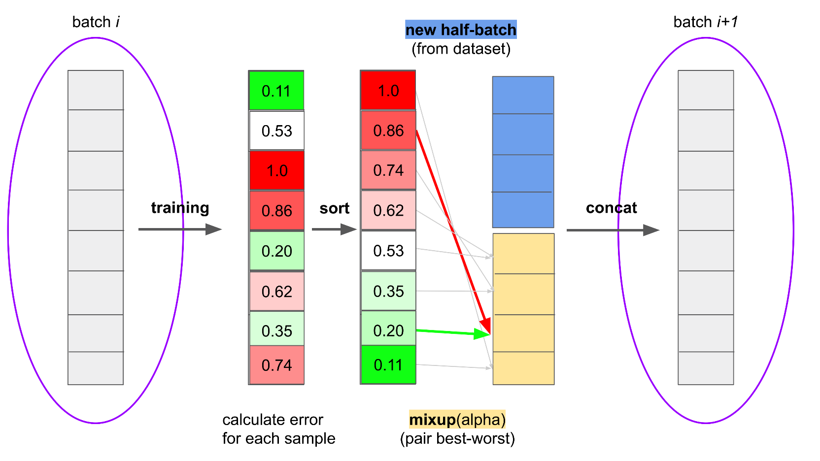
Explanation of BatchBoost
Pairing: Selecting image pairs which are easy-to-classify (low loss) and hard-to-classify (high loss)
Image samples from next batch
Mixing: Linearly combining selected images
Image samples from previous batch
Feeding: Fusing newly created images with the new input batch
Strategical Pairing
10

Slide 14
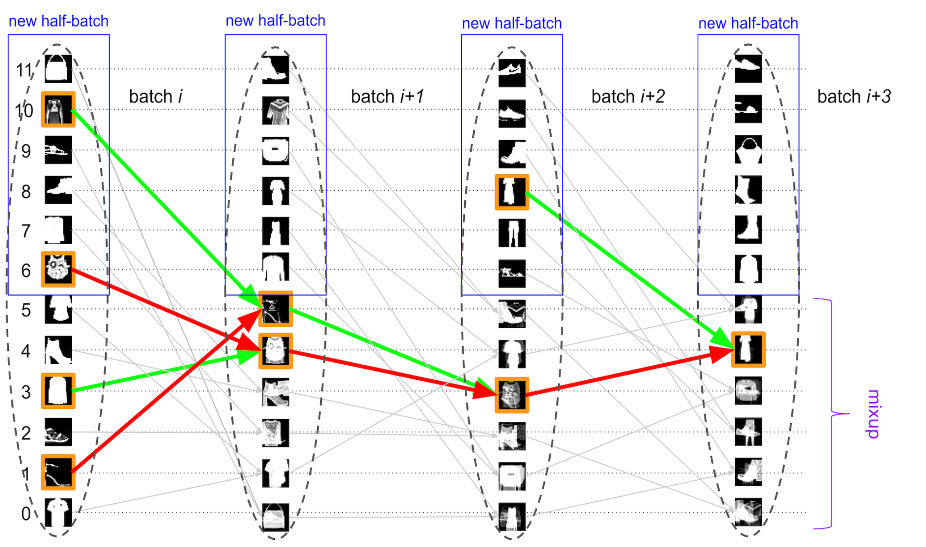
Why the name BatchBoost and how it helps?
Generated samples are kept in the training loop until the end of training. (Orange fenced image)
Gradient from the new samples remain in the network and helps the network stabilize and learn over period. In other words, the method is similar to what we do in any traditional boosting technique.
This method is applied on a batch rather than the dataset and hence the name.
11

Slide 15
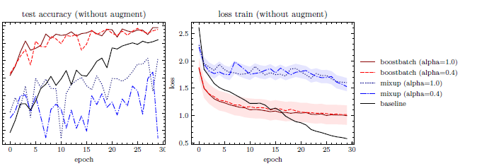
Comparison – Batchboost vs Mixup
Underfitting & Stabilizing Training
Fig: Evaluation for EfficientNet-b0 on CIFAR10; same hyperparameters for each model
Observation
Using Batchboost yields high testing accuracy than using Mixup
Mixup generates very unstable loss landscape while batchboost has stable decreasing Loss.

Slide 16
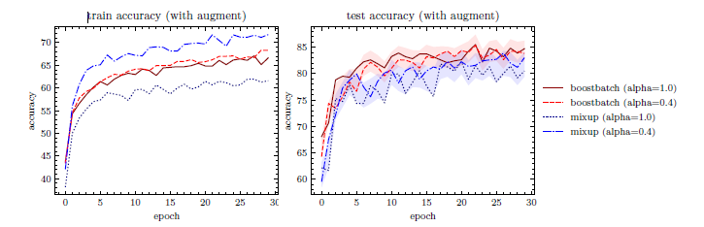
Comparison – Batchboost vs Mixup
Overfitting
Observation
Training accuracy of mixup model is more however testing accuracy of Batchboost model is high.
Batchboost have comparatively less difference between training nad testing accuracy than mixup model.
Mixup methodology tends to overfit the model while batchboost does not.

Slide 17
Results

Slide 18
Overall Experimental Methodology & Results
Transfer Learning + batchboost
Transfer Learning using EfficientNetb0
Deep CNN + Augmentation + Regularization
Deep CNN + Dropout + Normalization
98.71%
94.71%
87.17%
Deep CNN
78%
Baseline
67.20%
** Numbers represent Top 1 Accuracy on validation dataset (same across models)
65.87%
14

Slide 19
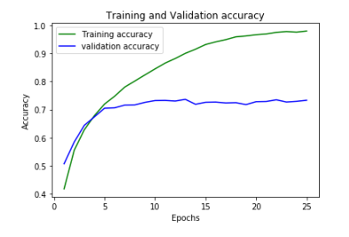
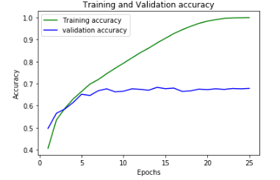
Training Results
Baseline Model
Top 1 Accuracy: 65.87%
Deep CNN Model
Top 1 Accuracy: 67.2%
High Overfitting!!
15

Slide 20
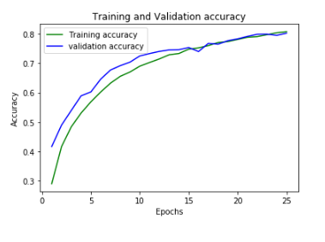
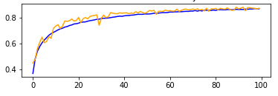
Training Results
Deep CNN + Dropout + Batch Normalization
Top 1 Accuracy: 78%
Deep CNN + Dropout + batch Normalization + Image Augmentation
Top 1 Accuracy: 87.17%
No Overfitting!!
16

Slide 21
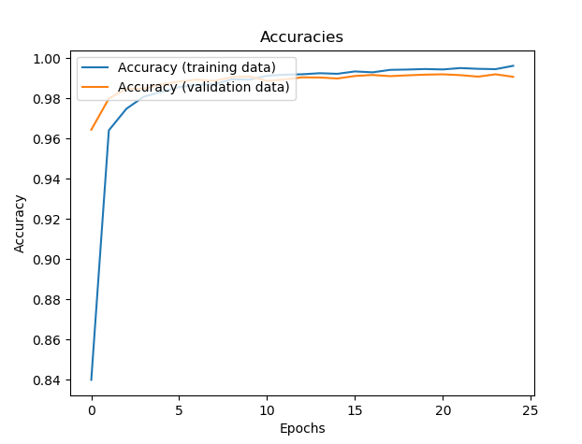
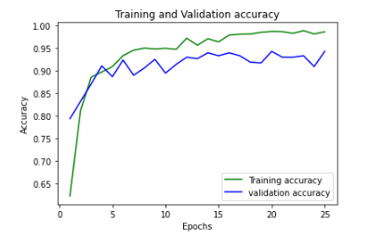
Training Results
Transfer Learning with EfficientNetb0
Top 1 Accuracy: 94.71%
Transfer Learning + batchboost
Top 1 Accuracy: 98.71%
Top 1 Accuracy improving over epochs!!
17

Slide 22
Conclusion and Target Conference
We observe that BatchBoost provides stability and gives better results than exiting state of the art regularization techniques. It has the property of avoiding Underfitting for misconfigured parameters and is a good regularization method for comparing two architectures without parameter tuning.
BatchBoost also retains all properties of techniques like: -
Mixup
SamplePairing
BC learning
Target Conference :-
CVAPP2020: Recent Advances in Computer Vision Applications Using Parallel Processing
Submission Deadline: 30th June, 2020
18

Slide 23
Thank You!

